Slide 1

Book Recommendation System
Group-2
Pavan Kumar Sahu
Sinduja T
Rugved Chaudhari
Azim Khan
Neeraj Kumar N.M
Krishna Nayak
Vaibhavi Jagtap

Slide 2
Contents :
Business Problem
Project Flow
Data Summary
EDA
Data Pre-processing
Data Visualization
Deployment
Conclusion

Slide 3
Introduction to Book Recommendation Systems
Enhancing User Experience
In the book industry, recommendation systems play a crucial role in enhancing user experience. These systems provide personalized book suggestions based on users' preferences, reading history, and other factors. By leveraging advanced algorithms and machine learning techniques, recommendation systems can help users discover new books that align with their interests and preferences.
Importance of Recommendation Systems
Recommendation systems are essential for both readers and book sellers. For readers, these systems make it easier to navigate through the vast amount of available books and find ones that are relevant and interesting to them. This personalized approach enhances user satisfaction and increases engagement with the platform. For book sellers, recommendation systems can drive sales by promoting books to users who are more likely to be interested in them. This targeted marketing approach can lead to higher conversion rates and customer loyalty.

Slide 4

Types of Recommendation Systems
Collaborative Filtering :
Collaborative filtering is a recommendation system that makes predictions about a user's interests by collecting preferences from many users. It uses the behavior and preferences of similar users to recommend items.
Content-Based Filtering :
Content-based filtering is a recommendation system that recommends items based on the similarity of their content to the user's preferences. It uses the attributes of the items and the user's past interactions to make recommendations.

Slide 5
Data Collection and Data Pre Processing :
Description
Step
1. Data Collection
Collecting relevant data from various sources such as online bookstores, libraries, and user reviews. This data can include information about book titles, authors, genres, descriptions, ratings, and user preferences.
Cleaning the collected data by removing duplicates, irrelevant information, and inconsistencies. This step also involves handling missing values and correcting any errors or inconsistencies in the dataset.
2. Data Cleaning
3. Data Integration
Integrating data from different sources into a unified dataset. This can involve merging datasets, resolving conflicts in data formats, and ensuring consistency in data representation.

Slide 6
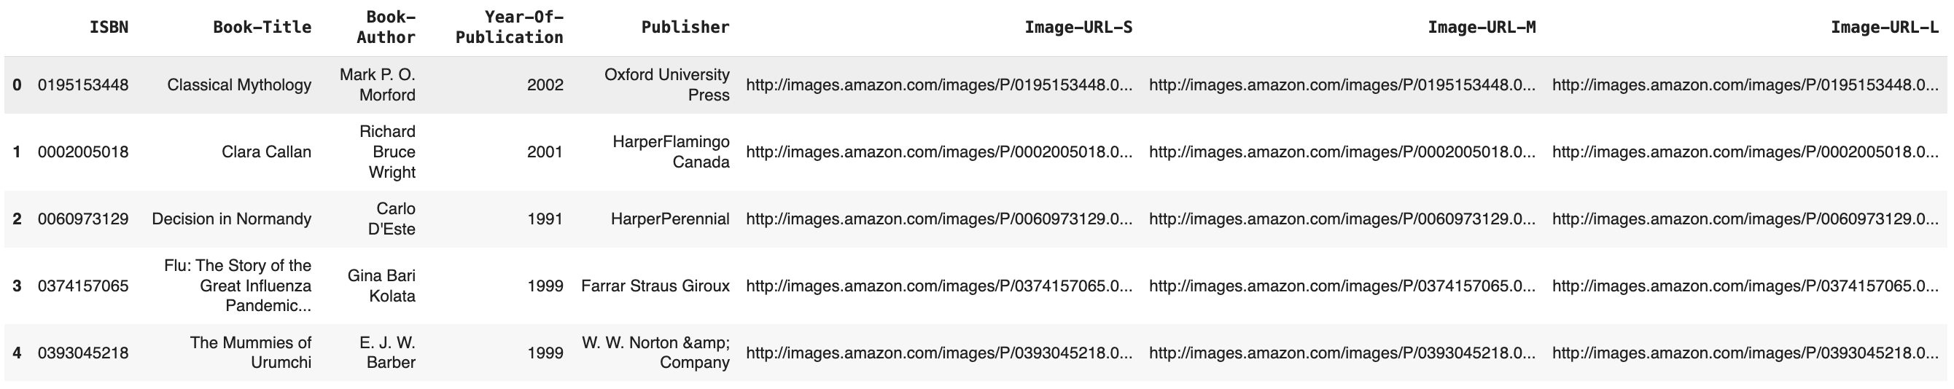
Data Description:
The Top 5 rows of the Data Frame book_df.

Slide 7
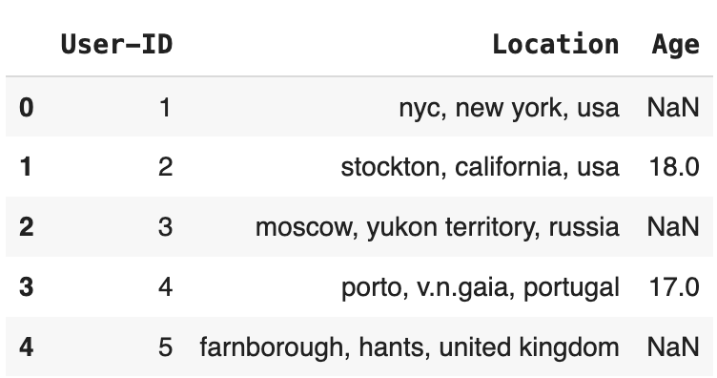
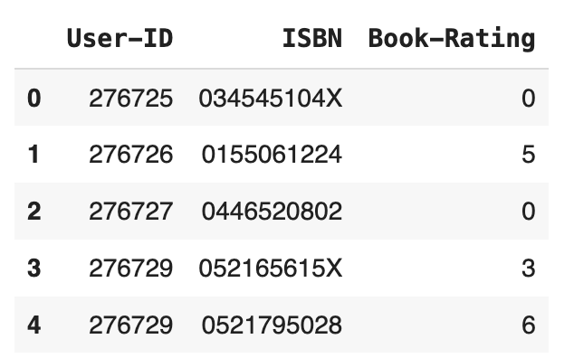
Data Description:
The Top 5 rows of the Data Frame User.
The Top 5 rows of the Data Frame Rating.

Slide 8
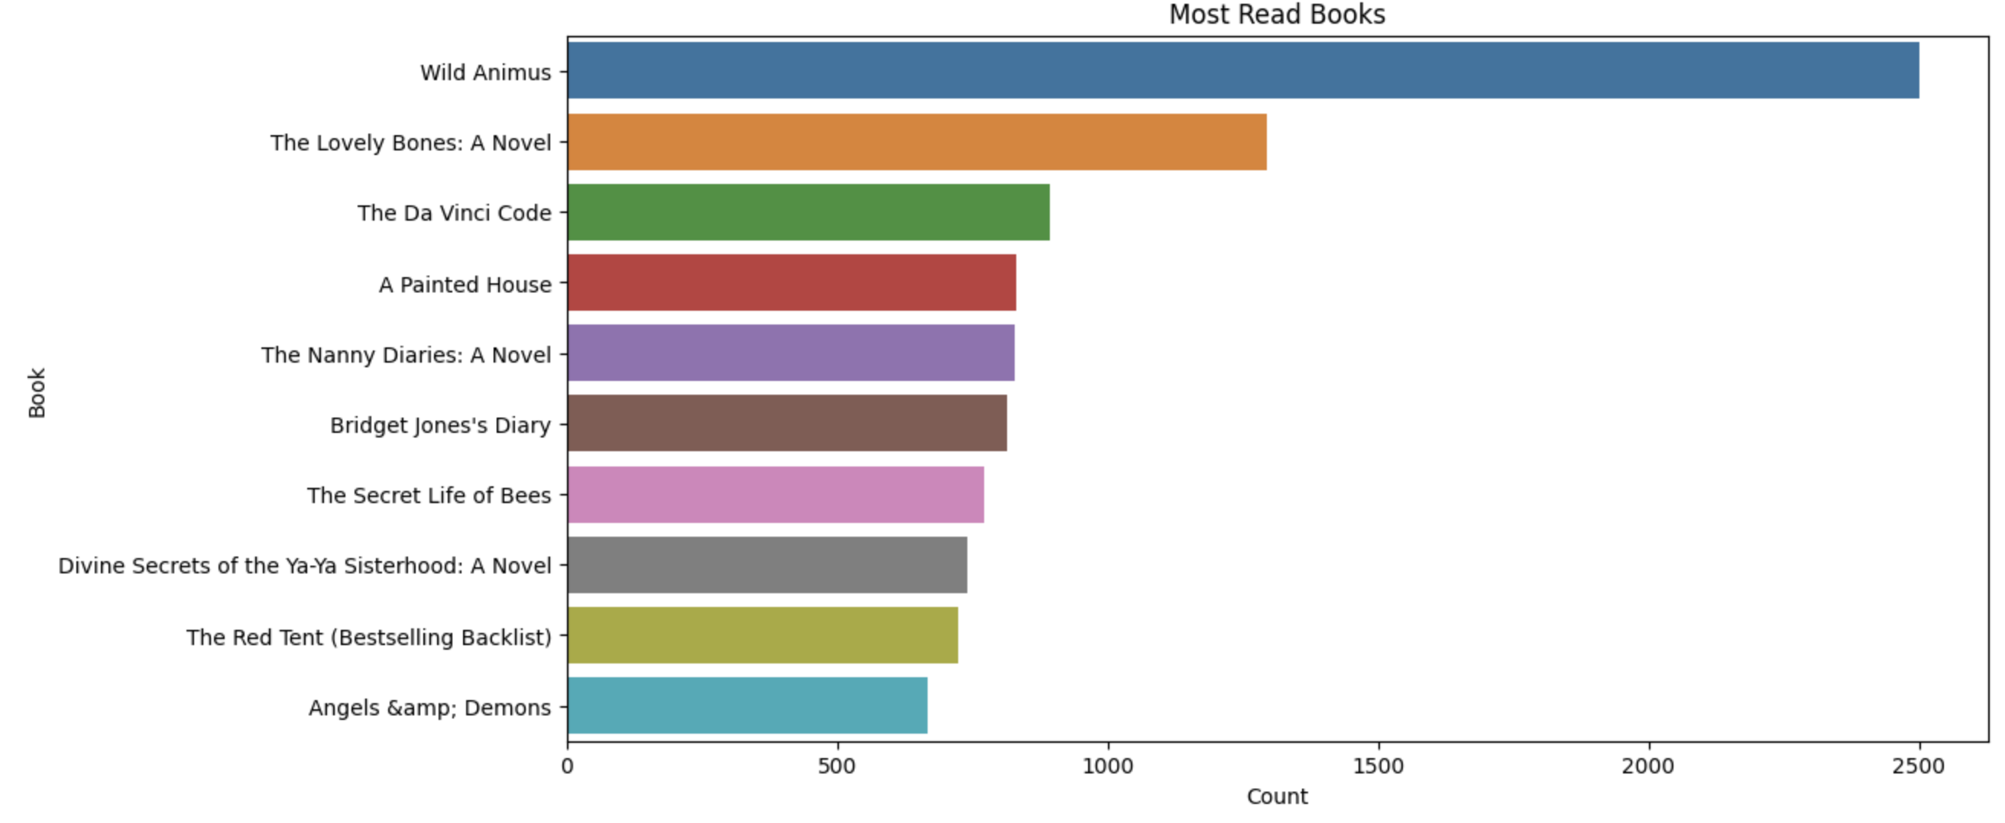
Exploratory Data Analysis :
Here as we see these are the top 10 books read by the Users.

Slide 9
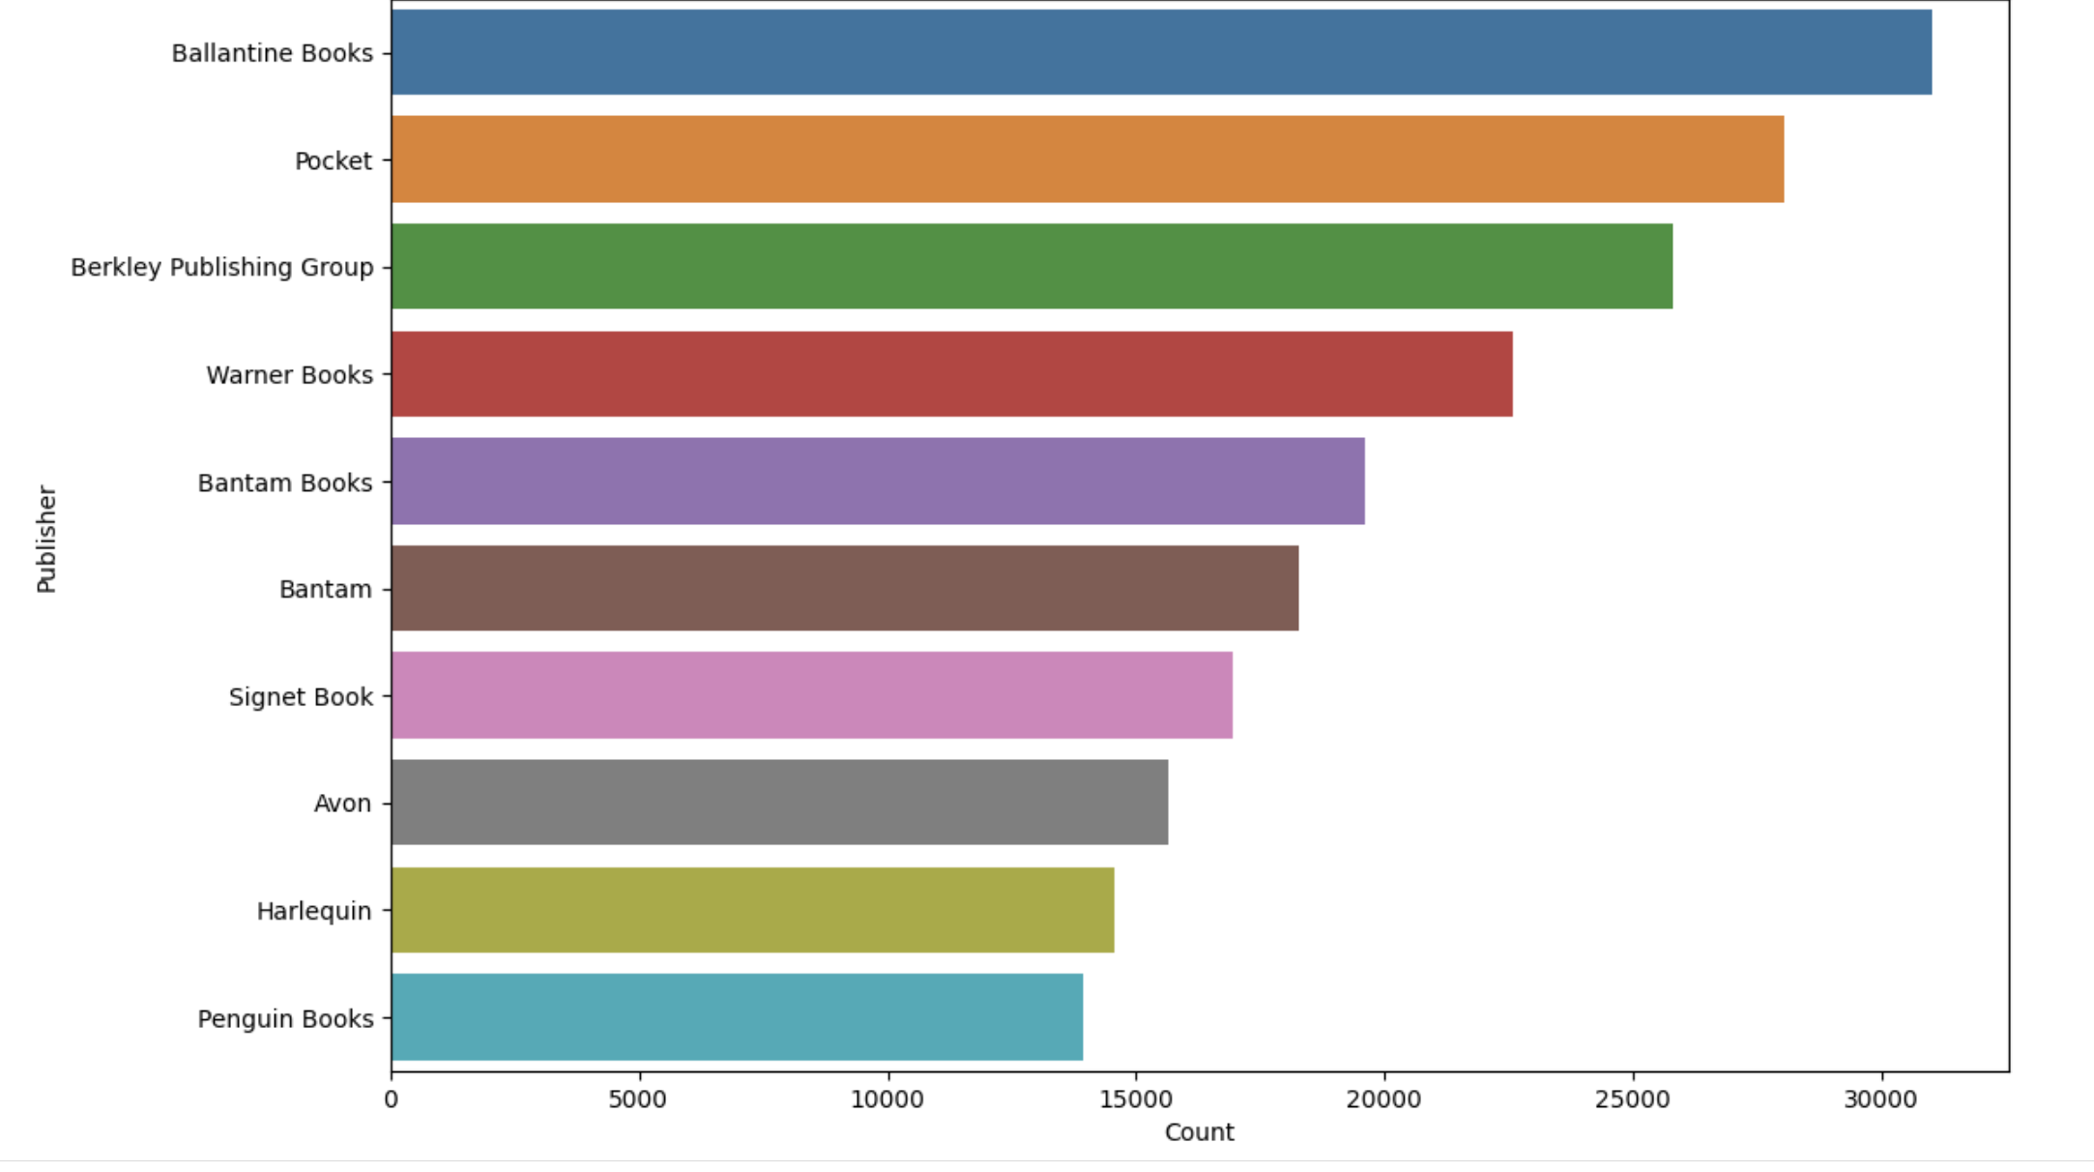
Exploratory Data Analysis :
Here as we see these are the top 10 Publishers .

Slide 10
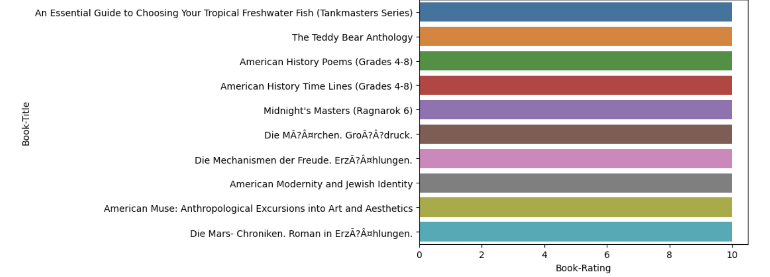
Exploratory Data Analysis :
Here as we see these are the top 10 Rated Books by the Users .

Slide 11
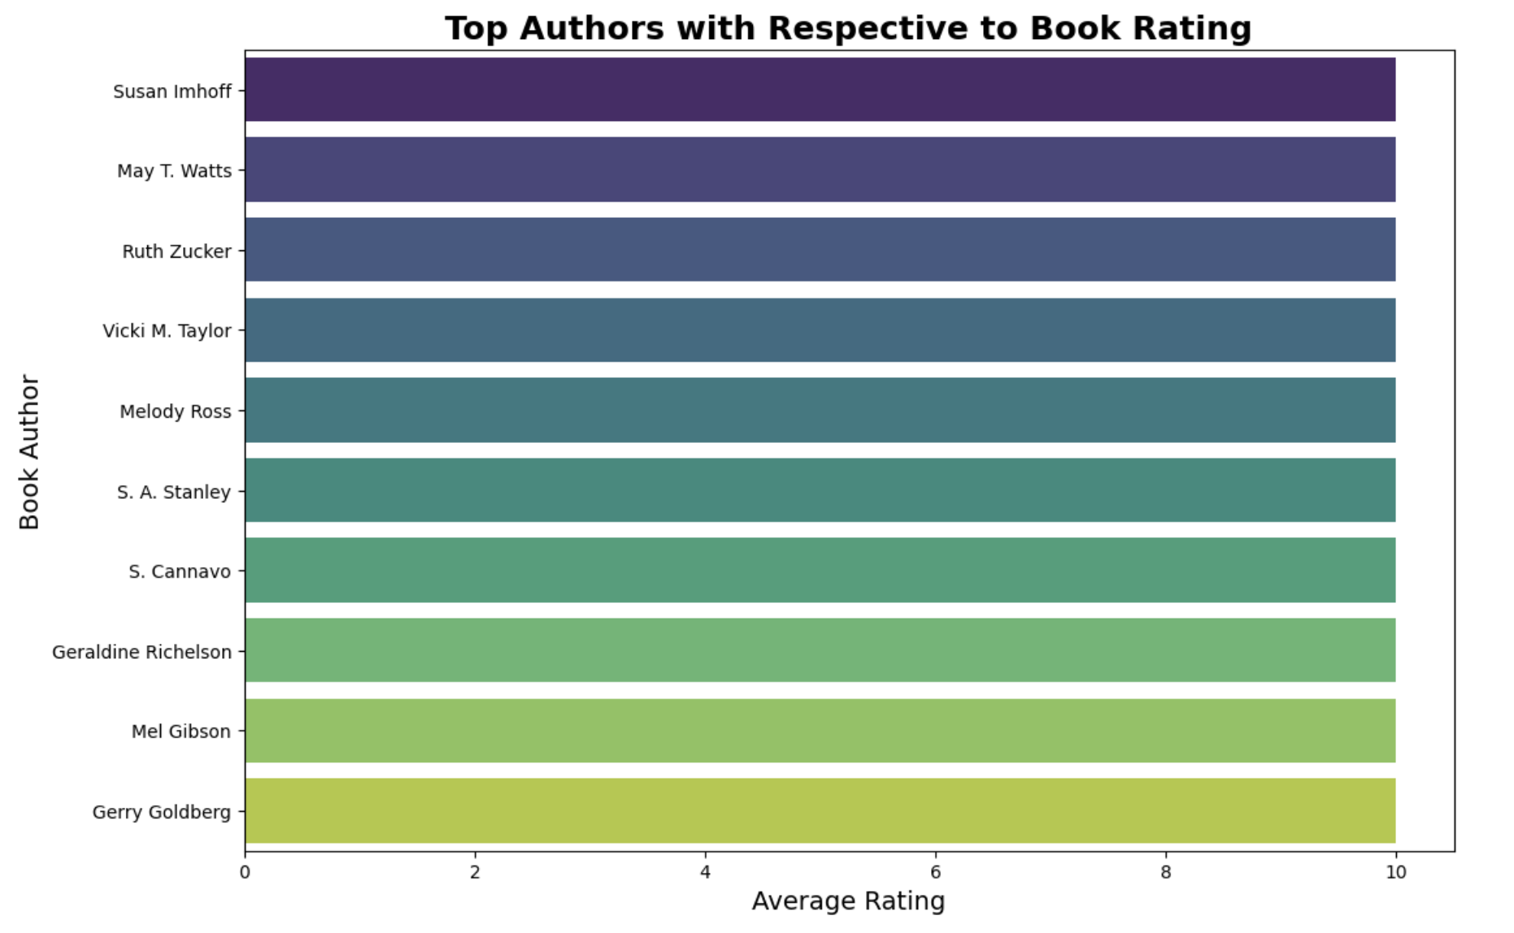
Exploratory Data Analysis :
Here as we see these are the top 10 Rated Authors by the Users .

Slide 12
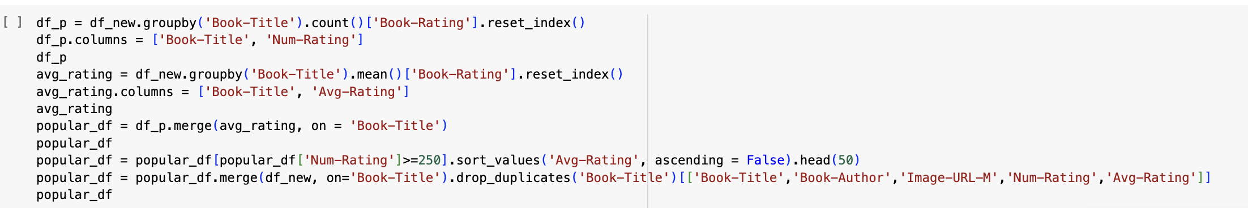
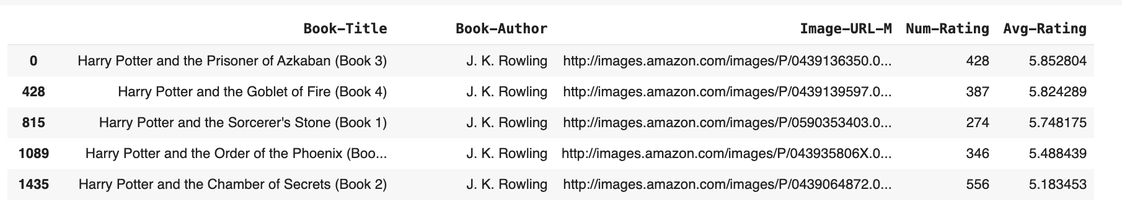
Popularity based recommendation system :
These are the top 5 Books Based on Popularity Based Recommendation System.

Slide 13
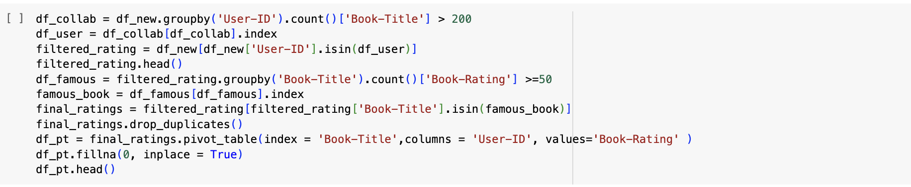
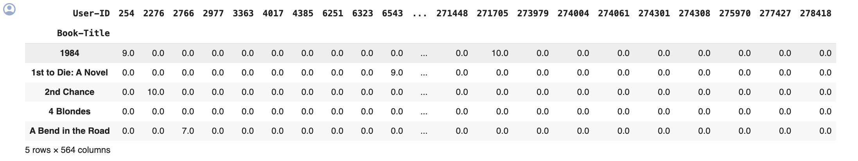
Collaborative Filtering based recommendation system :
These are the individual reviews given by the users to the Books Based on Collaborative Filtering Based Recommendation System.

Slide 14
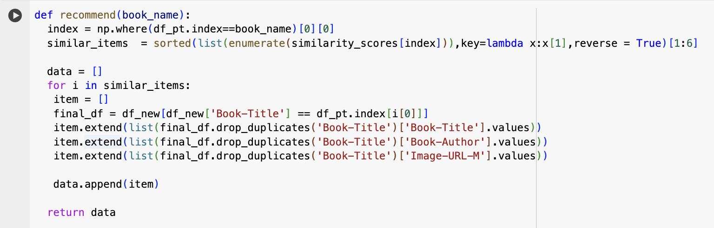
Defining a function named recommend that takes a book_name as input and aims to recommend similar items based on cosine similarity scores.

Slide 15
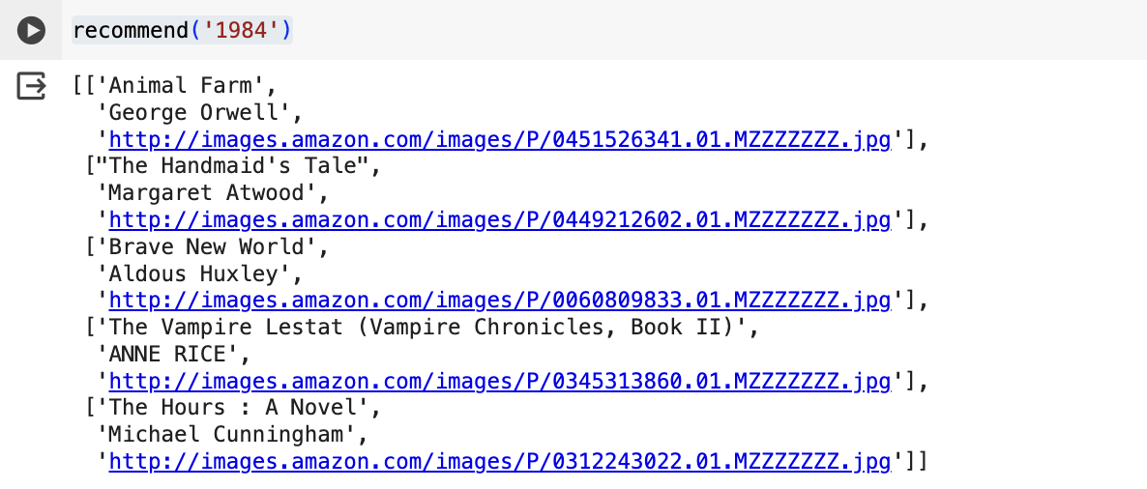
Recommending a book using Recommend Function :

Slide 16
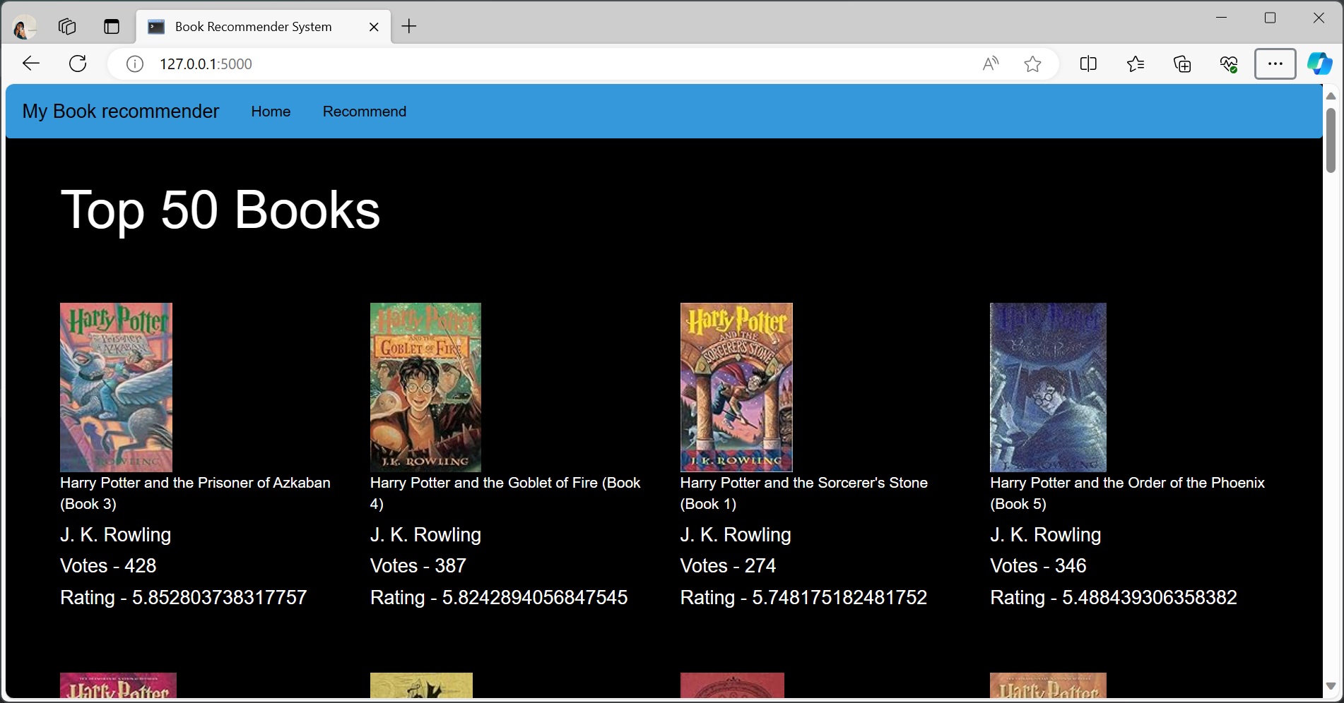
Deployment :
Top 50 Books Based on Content Based Recommendation System

Slide 17
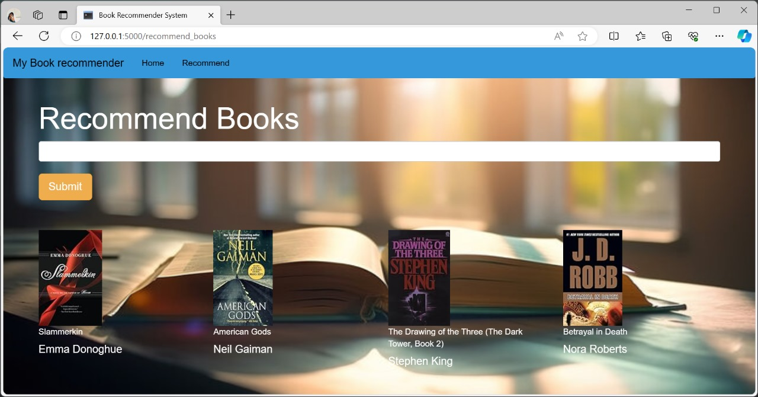
Deployment :
The Deployment Based on Popularity Based Recommendation System.

Slide 18
Conclusion :
This Book Recommendation System project in data science represents a significant advancement in personalized user experiences and content discovery. Through the integration of sophisticated machine learning algorithms and collaborative filtering techniques, we have successfully created a system that understands user preferences and provides tailored book recommendations. This project not only enhances user engagement but also opens up opportunities for increased user satisfaction and loyalty.

Slide 19
THANK YOU 🙏

